Slide 1
NoSQL Database

Slide 2
What is NoSQL Database ?
NoSQL is a non-relational database that is used to store the data in the nontabular form.
NoSQL stands for Not only SQL.

Slide 3
What is NoSQL Database ?
NoSQL is a non-relational database that is used to store the data in the nontabular form.
NoSQL stands for Not only SQL.

Slide 4
Types NoSQL Database ?
Document-based databases
Key-value stores
Column-oriented databases
Graph-based databases

Slide 5
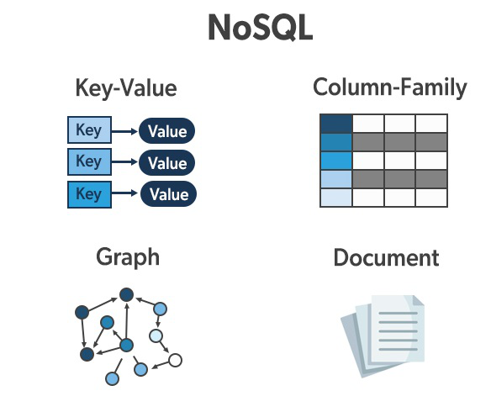
Types NoSQL Database ?

Slide 6
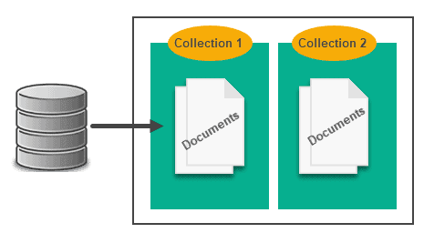
Document database (nosql)

Slide 7
What is document database ?
A document database, also known as a document-oriented database, is a type of NoSQL database that stores data in the form of documents, rather than in tables with rows and columns like a traditional relational database.
These documents can be in a variety of formats, such as JSON, BSON, or XML.

Slide 8
Document Data Model
In a document database, data is stored in the form of documents, which can include nested data structures. Each document can have a unique structure and can contain different fields. This is in contrast to a relational database, where data is stored in tables with a fixed schema.
An example of a document data model could be a collection of “users” where each document represents a single user and contains fields such as name, email, address, and preferences. An example of a document for a user could be:

Slide 9
Example
{
"_id": "12345",
"name": "John Smith",
"email": "john.smith@example.com",
"address": {
"street": "123 Main St",
"city": "Anytown",
"state": "NY",
"zip": "12345"
},
"preferences": {
"language": "en",
"notifications": true
},
"orders": [
{ "order_id": "54321", "total": 100 },
{ "order_id": "67890", "total": 50 }
]
}

Slide 10
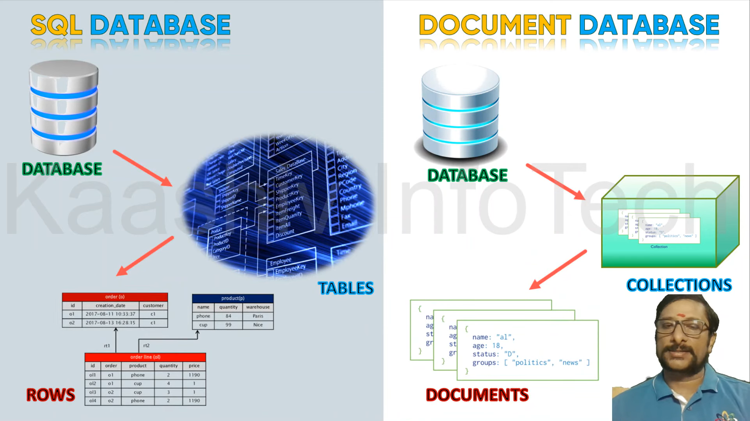

Slide 11
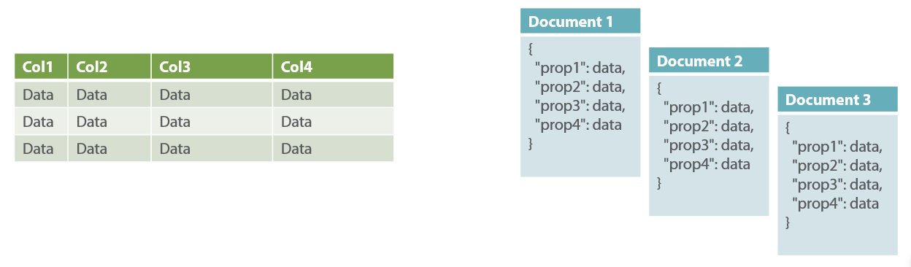

Slide 12
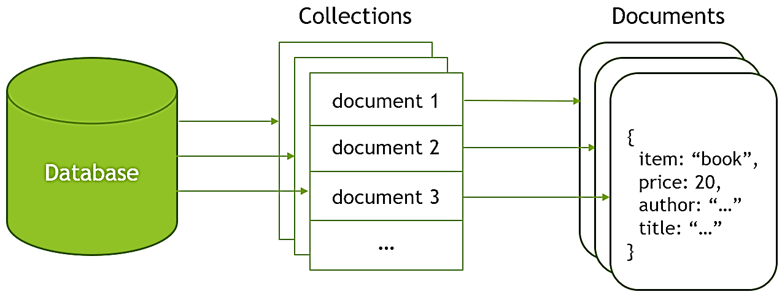

Slide 13
What Core Operations Document Database Support?
CRUD (Create, Read, Update, and Delete) operations: These are the basic operations for creating, reading, updating, and deleting documents in the database.
Indexing: Document databases often support indexing of documents, which allows for fast searching and querying of the data.
Aggregation: The ability to group and summarize data based on certain criteria, similar to SQL’s GROUP BY and aggregate functions.
Sharding: Distributes the data across multiple servers to improve performance and scalability.
Replication: Allows for multiple copies of the data to be stored on different servers for improved reliability and availability.
Data validation: Some document databases support data validation, which allows you to specify rules for how data is stored in the database.
Transactions: Document databases usually support atomic transaction operations for multiple documents, ensuring data consistency.

Slide 14
Use Cases of Document Database
Content management systems
E-commerce and retail
Social media
Gaming
IoT
Logging and monitoring
User data
Financial services

Slide 15
Advantages of Document Databases
Flexible schema
High performance
Scalability
Ease of use
Nested data structures

Slide 16
Disadvantages of Document Databases
Limited querying capabilities
Data consistency
Limited ACID support
Data validation
Backup and Recovery

Slide 17
Popular Document Databases
MongoDB
Couchbase
RavenDB
Amazon DocumentDB
Cloud Firestore
CosmosDB
CouchDB

Slide 18

MongoDB

